Slide 1

Student Details
Name: Sai Devi Sri Prasad Adigarla
Skills-build Email id: devisriprasad1969@gmail.com
College Name: Sir C R Reddy College Of Engineering
College State: Andhra Pradesh
Internship Domain: AI & ML
Internship start & end date : 3rd June to 15th July

Slide 2
Problem Statement: Employee Burnout Prediction
Predicting Employee Burnout Using Linear Regression
In Today’s workplaces, Employee Burnout is a serious issue that has an impact on overall organizational health, Employee satisfaction, and productivity . Reduced performance, higher turnover rates, and higher absenteeism are all possible outcomes of burnout . Organizations can better support their employees and preserve a healthy work environment by identifying and mitigating burnout early on.

Slide 3
Project Agenda: Employee Burnout Prediction
Establishing the project's objectives, deliverables, and success criteria, putting together a capable team, and defining its parameters are the first steps. We will then draft a detailed timetable with important milestones. In order to comprehend the dataset's structure, contents, and to spot patterns and anomalies, we will first compile it and perform exploratory data analysis, or EDA. We will handle missing values, outliers, and inconsistencies, scale numerical features, change categorical variables, and engineer new features during the data preprocessing phase. We will choose suitable machine learning algorithms for regression tasks, such as XGBoost, decision trees, random forests, and linear regression, after dividing the data into training and testing sets. The effectiveness of the model will be evaluated using metrics such as RMSE, MAE, and R2 score. The model's performance will then be optimized through hyperparameter tuning. Ultimately, we will examine the model's results to pinpoint the primary reasons behind employee burnout and offer the business practical suggestions for reducing it.

Slide 4
Project Overview: Employee Burnout Prediction
Predictive Modeling
Objective: Develop and train machine learning models to predict the burnout rate for each employee.
Data Insights
Objective: Analyze the data to uncover key factors contributing to employee burnout.
Actionable Recommendations
Objective: Provide insights and recommendations for organizations to effectively mitigate employee burnout.
Project Steps
Data Understanding and Exploration.
Data Preprocessing.
Model Development.
Model Evaluation and Insights.
Model Evaluation and Insights

Slide 5
WHO ARE THE END USERS of this project?
Employees
Management and Leadership
Human Resources (HR) Teams
Data Analysts and Researchers
Occupational Health and Safety (OHS) Officers

Slide 6
SOLUTION AND ITS VALUE PROPOSITION
The method entails creating a thorough predictive model to evaluate employee burnout depending on a number of variables, including job characteristics, mental health indicators, and demographics. This model will use cutting-edge machine learning techniques to analyze the dataset and identify important predictors of burnout. The following elements are part of the solution:
Proactive Burnout Management: Seek out and resolve possible burnout problems before they worsen.
Improved Well-Being of Employees: Encourage a more wholesome and encouraging work atmosphere.
Benefits for the Organization: Improve the culture and performance of the organization.
Data-Driven Decision Making: Make strategic decisions based on data insights.

Slide 7
Customization and Personalization of the Employee Burnout Prediction Project
Comprehensive Knowledge of Context
Advanced Methods for Processing Data
Choosing and Customizing a Model
Including Psychological Aspects
Framework for Continuous Improvement

Slide 8
Modelling with Linear Regression
Getting Ready for Data
Data splitting: Separate the training and testing sets from the dataset.
Feature Scaling: Bringing numerical attributes into uniformity.
Convert categorical variables into a numerical format by encoding them.
Models of Training
Linear Regression Model: Utilizing the training dataset, train the linear regression model.
Evaluation of the Model
Performance Metrics: To evaluate the model's performance, use metrics such as RMSE, MAE, and R2 score.
Model Modification
Feature Selection: To improve model performance, assess and choose the most crucial features.

Slide 9
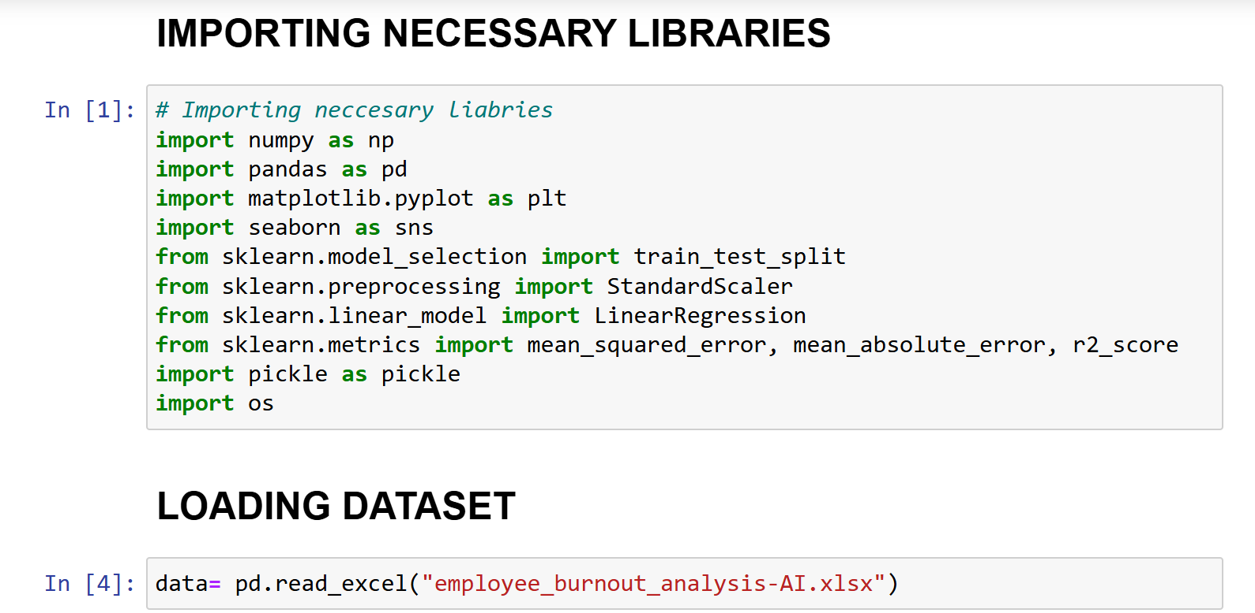
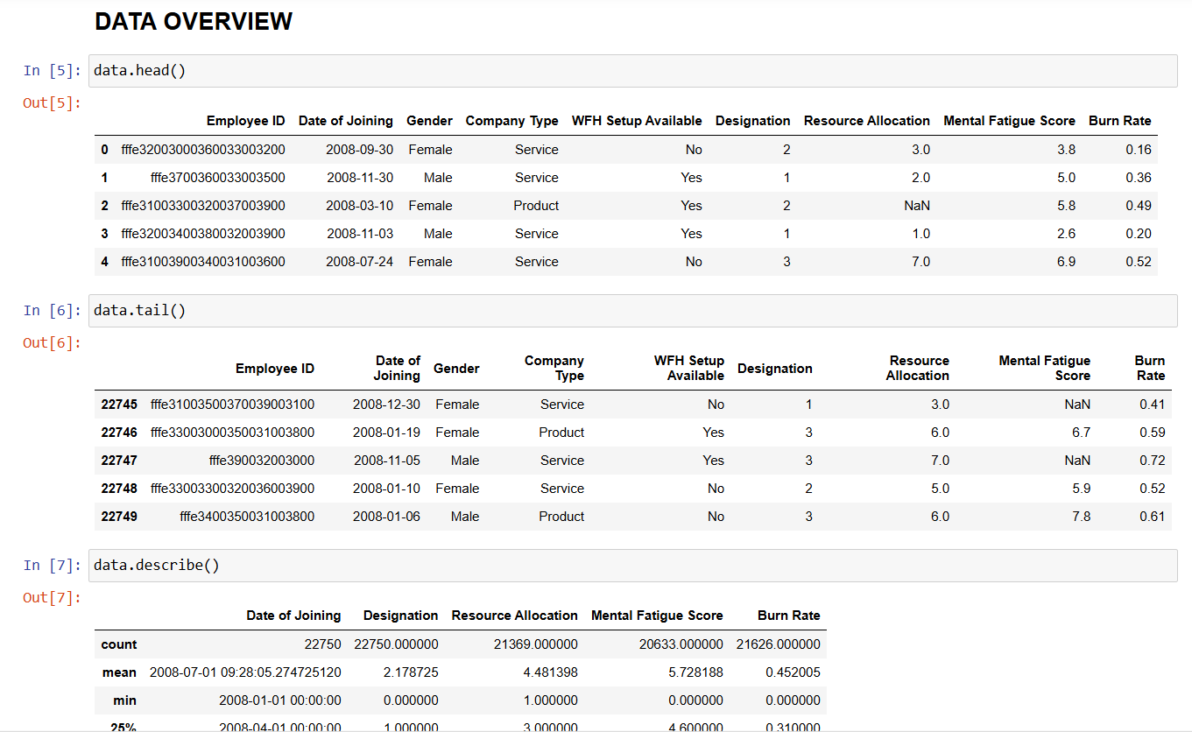
CODE CUSTOMIZATION

Slide 10
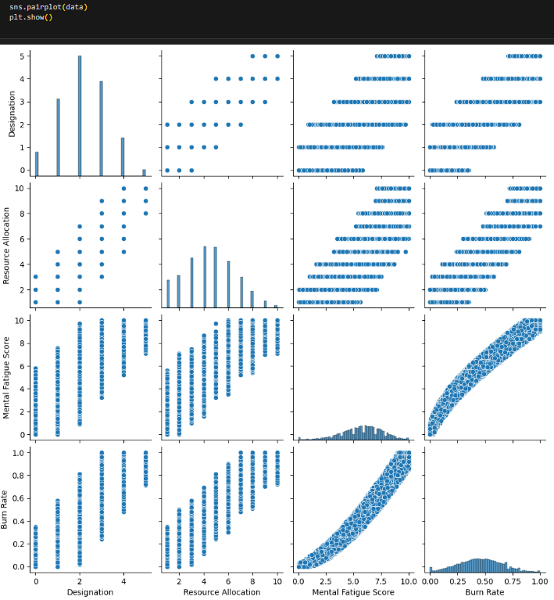
Result :

Slide 11
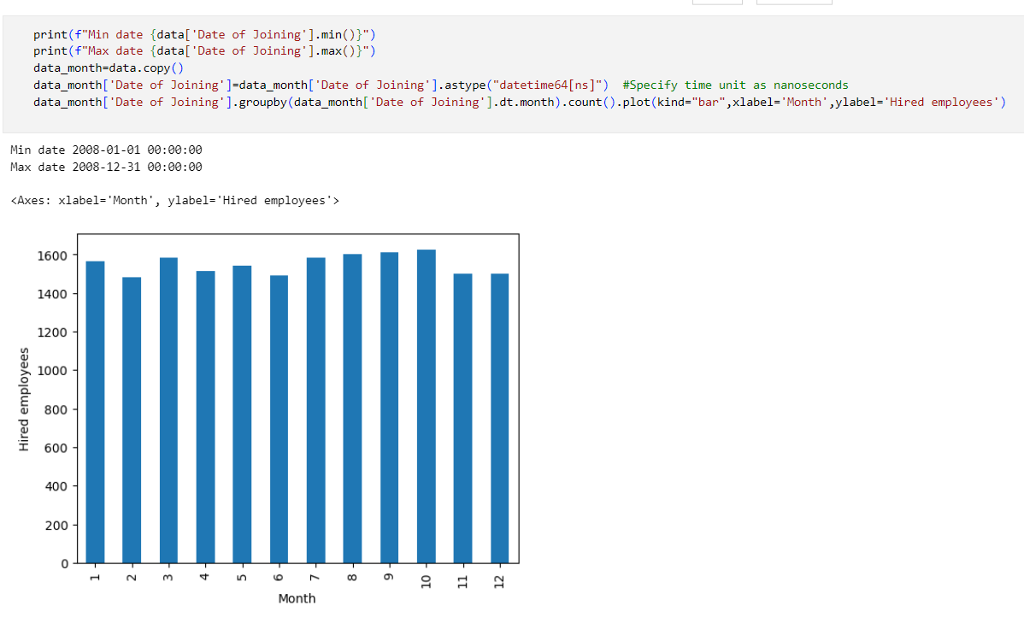
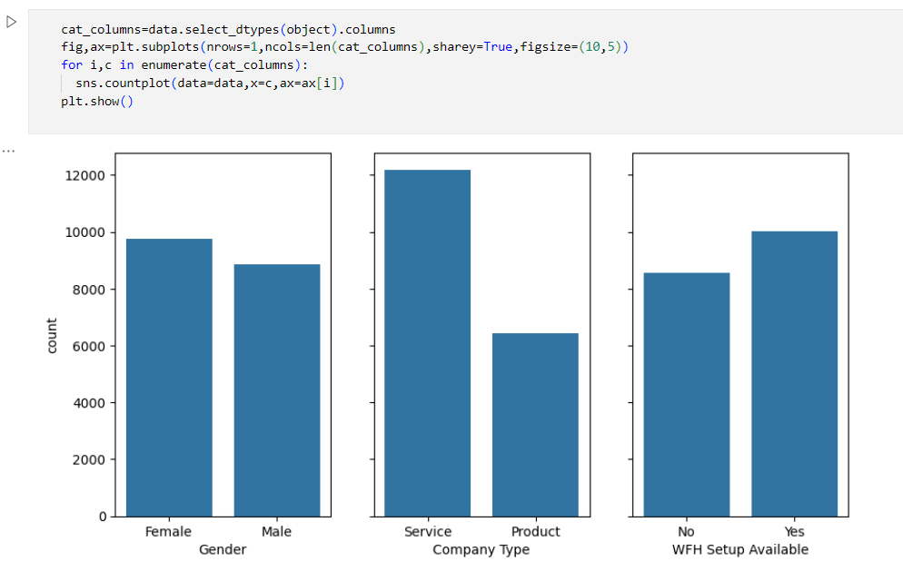

Slide 12
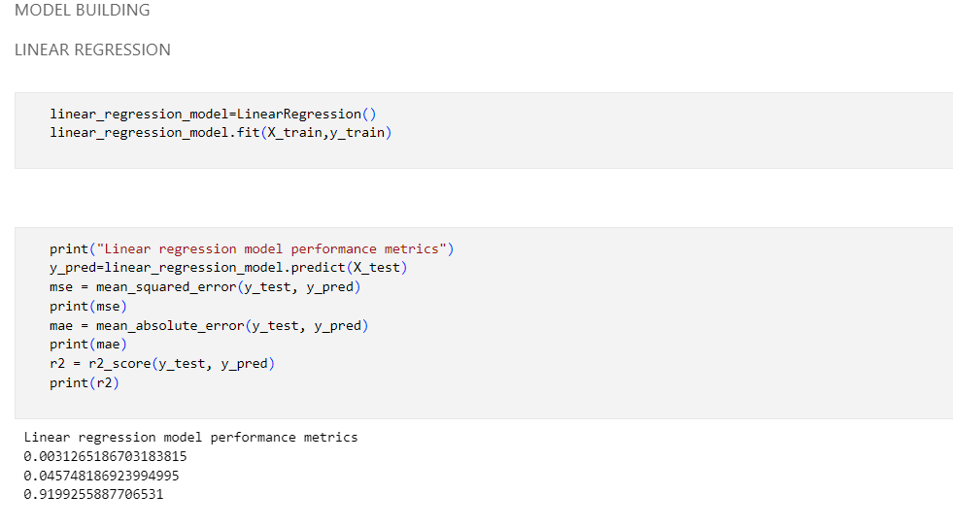
Model Building

Slide 13
LINKS
DATASET LINK : https://www.kaggle.com/datasets/blurredmachine/are-your-employees-burning-out
                MAIL : mailto:devisriprasad1969@gmail.com
                GOOGLE COLLAB LINK : https://colab.research.google.com/drive/1qFWF33-N53D-8vqN_jhVopT_SUTxB8F0?usp=drive_link
                GITHUB LINK : https://github.com/L1e2a3r4n5e6r7/Employee-Burnout-analysis.git

